Slide 1

Data Science Based Prediction System for a Company
Sandipan Chowdhury – 11500116049
Nishant Kumar – 11500116073
Olivia Mukherjee – 11500117011
Rahul Singh – 11500116061
PPT for Project (CS892)
Under the Supervision of
Mr. Subhasis Mallick, Assistant Professor, CSE Department
B.P. Poddar Institute Of Management and Technology

Slide 2
ACKNOWLEDGEMENT
We have taken efforts in this project. However, it would not have been possible without the kind support and help of many individuals. I would like to extend my sincere thanks to all of them.
We are highly indebted to Mr. Subhasis Mallick for his guidance and constant supervision as well as for providing necessary information regarding the project & also for their support in completing the project.
We would like to express our special gratitude and thanks to Mr. Subhasis Mallick for giving our attention and time. Our thanks and appreciations also go to my colleagues in developing the project and people who have willingly helped us out with their abilities.

Slide 3
Introduction
In this 21st century of technology, we are progressing towards smarter concepts and tools day by day. Nowadays it is possible to shop while sitting at home, by e-commerce. Just a mobile number or an email id and a bank account is needed to do online shopping. Various companies (like Amazon, Flipkart, Snapdeal etc.) provide us the facility of good online shopping.
These companies also seek help from various tools and concepts to get an idea about how they can increase their profit. Such a concept is Data Science. A Data Scientist can analyze the sales data of an e-commerce company, and build a recommendation system to give an optimized business strategy to that company.

Slide 4
Objectives
In this project, we have 1 dataset of Amazon Company …… one containing informations about customers. We will analyze these datasets with linear regression and logistic regression, and calculate the optimized business strategy for Amazon Company for next year.

Slide 5
Defining Project and Gathering Background Knowledge
Learning of Data Science and Predictive Model
Learning of Linear Regression and Logistic Regression
Working Steps
Discussions on the topics we learnt
Analysis of Datasets
Procurement of Project’s Solution

Slide 6
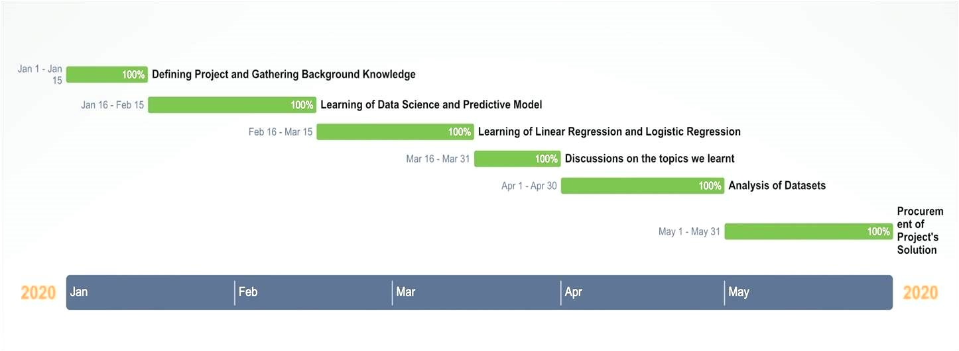
Activity Chart (Gantt Chart)

Slide 7
Data Science
1) Data science is a multi-disciplinary field that uses scientific methods, processes, algorithms and systems to extract knowledge and insights from structured and unstructured data.
2) Data science is the same concept as data mining and big data: "use the most powerful hardware, the most powerful programming systems, and the most efficient algorithms to solve problems".
3) Data science is a "concept to unify statistics, data analysis, machine learning and their related methods" in order to "understand and analyze actual phenomena" with data.
4) Turing award winner Jim Gray imagined data science as a "fourth paradigm" of science (empirical, theoretical, computational and now data-driven) and asserted that "everything about science is changing because of the impact of information technology" and the data deluge.

Slide 8
Linear Regression
1) In statistics, linear regression is a linear approach to modeling the relationship between a scalar response (or dependent variable) and one or more explanatory variables (or independent variables).
2) The case of one explanatory variable is called simple linear regression. For more than one explanatory variable, the process is called multiple linear regression. This term is distinct from multivariate linear regression, where multiple correlated dependent variables are predicted, rather than a single scalar variable.
3) In linear regression, the relationships are modeled using linear predictor functions whose unknown model parameters are estimated from the data. Such models are called linear models.

Slide 9
Predictive Models
1) Predictive modeling uses statistics to predict outcomes. Most often the event one wants to predict is in the future, but predictive modeling can be applied to any type of unknown event, regardless of when it occurred. For example, predictive models are often used to detect crimes and identify suspects, after the crime has taken place.
2) In many cases the model is chosen on the basis of detection theory to try to guess the probability of an outcome given a set amount of input data, for example given an email determining how likely that it is spam.
3) Models can use one or more classifiers in trying to determine the probability of a set of data belonging to another set. For example, a model might be used to determine whether an email is spam or "ham" (non-spam).
4) Depending on definitional boundaries, predictive modeling is synonymous with, or largely overlapping with, the field of machine learning, as it is more commonly referred to in academic or research and development contexts. When deployed commercially, predictive modeling is often referred to as predictive analytics.

Slide 10
Logistic Regression
1) In statistics, the logistic model (or logit model) is used to model the probability of a certain class or event existing such as pass/fail, win/lose, alive/dead or healthy/sick. This can be extended to model several classes of events such as determining whether an image contains a cat, dog, lion, etc. Each object being detected in the image would be assigned a probability between 0 and 1 , and the sum adding to one.
2) Logistic regression is a statistical model that in its basic form uses a logistic function to model a binary dependent variable, although many more complex extensions exist.

Slide 11
Confusion Matrix
1) In the field of machine learning and specifically the problem of statistical classification, a confusion matrix, also known as an error matrix, is a specific table layout that allows visualization of the performance of an algorithm, typically a supervised learning one (in unsupervised learning it is usually called a matching matrix).
2) Each row of the matrix represents the instances in a predicted class while each column represents the instances in an actual class (or vice versa). The name stems from the fact that it makes it easy to see if the system is confusing two classes (i.e. commonly mislabeling one as another).
3) It is a special kind of contingency table, with two dimensions ("actual" and "predicted') of "classes" in both dimensions (each combination of dimension and class is a variable in the contingency table).

Slide 12
E-Commerce
1) E-commerce (electronic commerce) is the activity of electronically buying or selling of products on online services or over the Internet. Electronic commerce draws on technologies such as mobile commerce, electronic funds transfer, supply chain management, Internet marketing, online transaction processing, electronic data interchange (EDI), inventory management systems, and automated data collection systems.
2) E-commerce is in turn driven by the technological advances of the semiconductor industry, and is the largest sector of the electronics industry.
3) Modern electronic commerce typically uses the World Wide Web for at least one part of the transaction's life cycle although it may also use other technologies such as e-mail. Typical e-commerce transactions include the purchase of online books (such as Amazon) and music purchases (music download in the form of digital distribution such as iTunes Store), and to a less extent, customized/personalized online liquor store inventory services. There are three areas of e-commerce: online retailing, electronic markets, and online auctions. E-commerce is supported by electronic business.

Slide 13
Result and Discussion
We have used one dataset . Dataset A contains information about customers. It includes ……
a) Name of Customers
b) Email ID of Customers
c) Phone number of Customers
d) Average time spent on App by each Customer (Minutes / Day)
e) Total Purchase from App by each Customer (Rupees / Year)
f) Average time spent on Website by each Customer (Minutes / Day)
g) Total Purchase from Website by each Customer (Rupees / Year)
h) Length of Membership of each Customer (Year)
i) Yearly Amount Spent by each Customer (Minutes / Year)
j) Total Purchase of each Customer (Rupees / Year)
k) Ratings given by Customer (Out of 5)

Slide 14
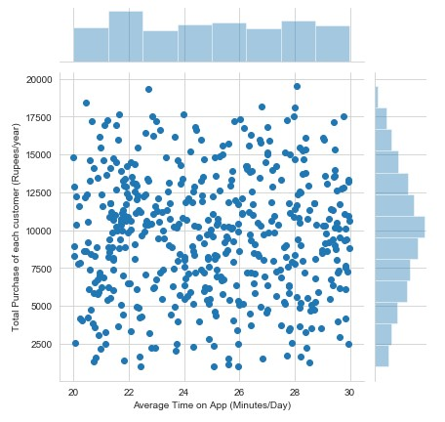
Graph on Total purchase of each customer vs Average time on app

Slide 15
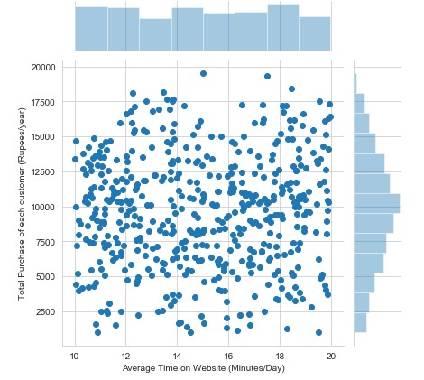
Graph on Total purchase of each customer vs Average time on website

Slide 16
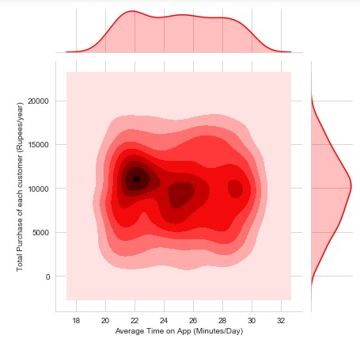
Graph on Total purchase of each customer vs Average time on app

Slide 17
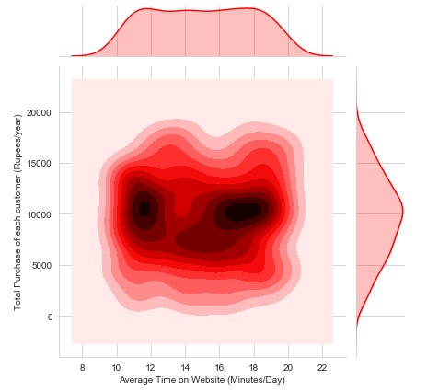
Graph on Total purchase of each customer vs Average time on website

Slide 18
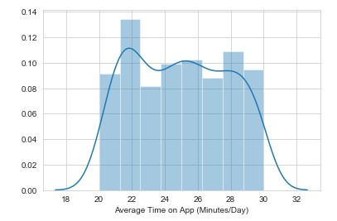
Distributed Plot on Average time on app

Slide 19
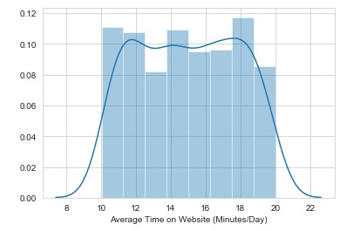
Distributed Plot on Average time on website

Slide 20
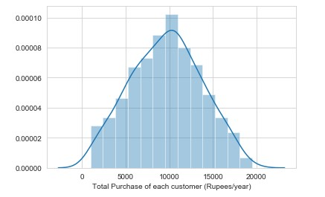
Distributed Plot on Total Purchase of each customer

Slide 21


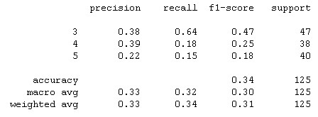
We have applied linear regression and logistic regression to our datasets. From those analysis, we have calculated the coefficients of important attributes, and also confusion matrix and classification report. The attribute with highest coefficient has highest importance.

Slide 22
Our Data Science based analysis shows that “Average Time on Website” has highest coefficient (59.398727).
So it is convenient that “Average Time on Website” is most important.
Therefore to maximize profit, business strategy of next year should be based on “Average Time on Website”.

Slide 23
References
Internet Links →
a) https://en.wikipedia.org/wiki/E-commerce
b) https://en.wikipedia.org/wiki/Data_science
c) https://en.wikipedia.org/wiki/Predictive_modelling
d) https://en.wikipedia.org/wiki/Predictive_analytics
e) https://en.wikipedia.org/wiki/Prediction
f) https://www.investopedia.com/terms/d/data-science.asp
g) https://en.wikipedia.org/wiki/Regression_analysis

Slide 24
Books→
a) Business Analytics: The Science of Data - Driven Decision Making, Wiley Publications
b) Predictive Analytics for Dummies, Wiley Publications
c) Applied Machine Learning, Tata McGraw Hills Publications
d) Advanced Engineering Mathematics, Wiley Publications

Slide 25
THANK YOU

